Slide 1



NATIONAL SCIENTIFIC AND TECHNICAL
RESEARCH COUNCIL
ACTIONS TOWARDS GENDER EQUITY
Dr. Ana Franchi
President
Notes:
1

Slide 2

CONICET is the main agency that fosters science and technology in Argentina.
It was created in 1958. The first president of CONICET was Bernardo A. Houssay –Nobel Prize winner in Medicine in 1947.
Currently, CONICET is an autarchic entity that depends on the Ministry of Science, Technology and Innovation.
The Council’s mission is to foster and implement scientific and technological activities in the whole territory and all areas of knowledge.
Notes:
2

Slide 3

CONICET
Areas of knowledge: biomedical, natural & formal sciences, engineering & technology, social sciences & humanities.
+ 11000 full-time researchers
+ 2700 technical & research assistants
+ 1300 administrative & professional staff
+12000 scholarships for PhD and post-doctorate students
Notes:
3

Slide 4
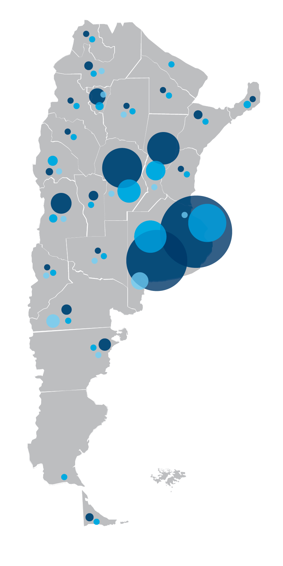
FEDERALIZATION OF SCIENCE
CONICET researchers all across the countries’ universities and Science and Technology entities
CONICET Researchers distribution
CONICET Research centers
Universities (National/Private)
Science and Technology organisms
Notes:
4

Slide 5
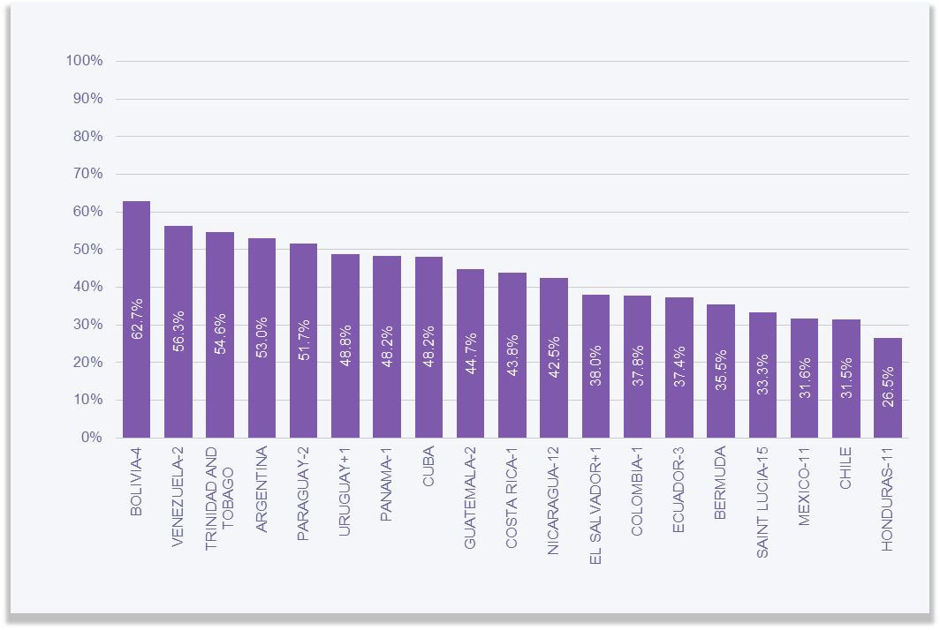
Female Scientists in Latin America
Source: UNESCO Institute for Statistics, June 2019.
53% in Argentina
Notes:
5

Slide 6
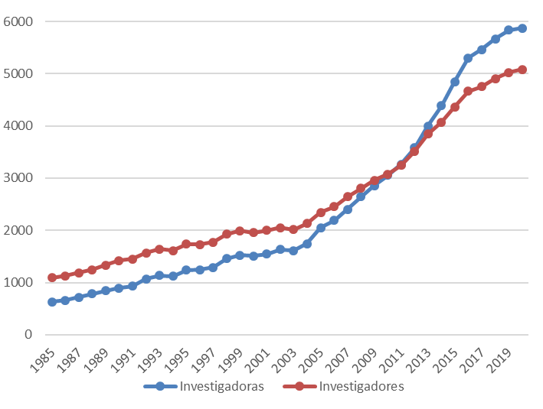
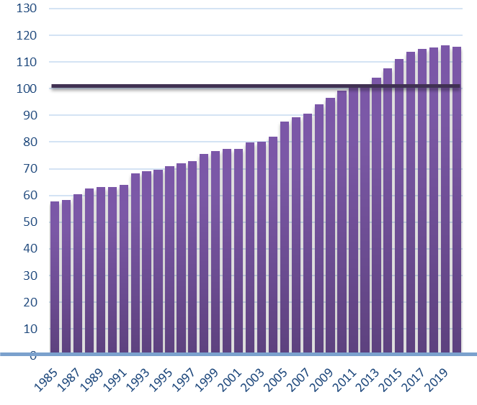
Evolution of the quantity of both
female (in blue) and male (in red) researchers
1985-2020
Female researchers per 100 researchers
1985 -2020
Notes:
6

Slide 7
Researchers at CONICET by Gender (2010 – 2020)
WOMEN: FROM 49% in 2010 TO 53% in 2020
YEAR | WOMEN | WOMEN % | MEN | MEN % | TOTAL
2010 | 3064 | 49.68% | 3104 | 50.32% | 6168
2011 | 3364 | 50.10% | 3350 | 49.90% | 6714
2012 | 3598 | 50.37% | 3545 | 49.63% | 7143
2013 | 4029 | 50.99% | 3873 | 49.01% | 7902
2014 | 4410 | 51.83% | 4098 | 48.17% | 8508
2015 | 4856 | 52.58% | 4380 | 47.42% | 9236
2016 | 5338 | 53.19% | 4698 | 46.81% | 10036
2017 | 5477 | 53.41% | 4778 | 46.59% | 10255
2018 | 5687 | 53.55% | 4932 | 46.45% | 10619
2019 | 5874 | 53.81% | 5043 | 46.19% | 10917
2020 | 5905 | 53.64% | 5102 | 46.35% | 11007
Source: Office of Strategic Information in HHRR. Data processed every December
Information available on www.conicet.gov.ar
Notes:
7

Slide 8
Distribution according to highest category achieved
by period of entry
1985 - 1989
(women on the left – Green)
(men on the right – Violet)
1990 – 1994
Categories (from low to high):
Assistant, Associate/Adjunt, Independent, Principal and Senior
Notes:
8

Slide 9
RESEARCHERS BY CATEGORY AND GENDER
FROM JUNIOR TO SENIOR (2020)
CATEGORY | WOMEN | WOMEN % | MEN | MEN % | TOTAL
ASSISTANT | 1561 | 61.09% | 994 | 38.90% | 2555
ASSOCIATE | 2427 | 56.67% | 1855 | 43.32% | 4282
INDEPENDENT | 1352 | 49.39% | 1385 | 32.34% | 2737
PRINCIPAL | 511 | 41.95% | 707 | 58.04% | 1218
SUPERIOR | 54 | 25.11% | 161 | 74.88% | 215
TOTAL | 5905 | 53.64% | 5102 | 46.35% | 11007
Source: Office of Strategic Information in HHRR. December 2020
Notes:
9

Slide 10
RESEARCHERS’ DISCIPLINE BY GENDER
AREA OF STUDY | WOMEN | WOMEN % | MEN | MEN % | TOTAL
Agrarian, Engineering and Material Sciences | 1358 | 53.21% | 1194 | 46.79% | 2552
Biological and Health Sciences | 1969 | 61.28% | 1244 | 38.72% | 3213
Social Sciences and Humanities | 1406 | 57.55% | 1037 | 42.45% | 2443
Formal and Natural Sciences | 991 | 41.69% | 1386 | 58.31% | 2377
TECHNOLOGY | 150 | 45.18% | 182 | 54.82% | 332
Source: Office of Strategic Information in HHRR. December 2019
Notes:
10

Slide 11
DIFFERENCES ACCORDING TO AREAS & DISCIPLINES
MORE WOMEN IN MOST AREAS (BIOMEDICAL, ENGINEERING & SOCIAL) AND DISCIPLINES (ANTHROPOLOGY, BIOTECHNOLOGY, PSYCHOLOGY, EDUCATION, MEDICINE)
LESS WOMEN IN THE AREA OF NATURAL SCIENCES AND IN SOME DISCIPLINES (PHYSICS, INFORMATICS, ECONOMICS)
UNESCO SURVEY REGARDING KIDS PERFORMANCE IN STEM
46% BELIEVE THERE ARE DIFFERENCES BETWEEN BOYS AND GIRLS REGARDING STEM PERFORMANCE (BOYS WOULD HAVE A BETTER DEVELOPMENT)*
*UNESCO Regional Chair Women Science and Technology in Latin America - FLACSO Argentina with the Civil Association Chicos.net, and with the support of Disney Latin America.
Notes:
11

Slide 12
BACKGROUND
LEGAL FRAMEWORK IN ARGENTINA
  Gender quotas (1991) / parity (2019) in political representation
  CEDAW & other UN & Inter-american human rights conventions within the Argentine Constitution (1994)
  Equal (Gay & Lesbian) Marriage (2010)
  Transgender Identity Law (2012)
  Law “Micaela” – Mandatory training on gender for every public officer & employee (judiciary, congress, executive, incl. public organisms like CONICET) (2018)
  Ministry of Women, Gender and Diversity (2019)
  Abortion Law (2020)
  Positive discrimination for transgender (quotas) within the public sector (2020)
Notes:
12

Slide 13
ONGOING INITIATIVES IN CONICET
ACTIONS
Beyond MATERNITY LEAVE
Female fellows may request maternity leave for 100 calendar days (minimum of 30 days and maximum of 45 days prior the estimated date of delivery)
Extension of the current scholarship for an equal to the period of the leave of absence
Female researchers are exempted from presenting the annual report in the year in which they had a child
Extension on the scholarship applications period due to pregnancy
Care and careers: adaptation of maternity and paternity leaves (also: recognition of same-sex couples and homo-parenthood) – other “care measures”
Notes:
13

Slide 14
ACTIONS
Creation of an Observatory of gender-based violence
and violence at the workplace
Protocols & guidelines (2019) aiming at creating safe and reliable spaces for affected people to share their situation/their experiences,
  Creation of spaces of counselling and reception of complaints – Pilot experiences in 11 regions & in partnership with universities
  Creation of instruments and guidelines in response to gender—based violence and violence at the work place, an information system (register file) & a website (in progress)
  Production of information material
  Seminars and trainings – Law “Micaela”
Notes:
14

Slide 15
ACTIONS
Inter-institutional articulation
  Ministry of Science: Creation of a National Program for Gender Equality in Science, Technology and Innovation
  Ministry of Woman, Gender and Diversity: special recognition of the scientific work against COVID-19
  L’Oréal – UNESCO: “For Women in Science” Award and Special Mentions to female researchers
  Global Reaserch Council: active participation in gender working groups of different entities like GRC
  Argentine Presidency: special event in Casa Rosada (Government’s Main Building) the Salón de los Científicos (Male Scientists Room) became the Salón de la Ciencia Argentina (Argentine Science Room) including pictures of Argentinean female scientists
Notes:
15

Slide 16
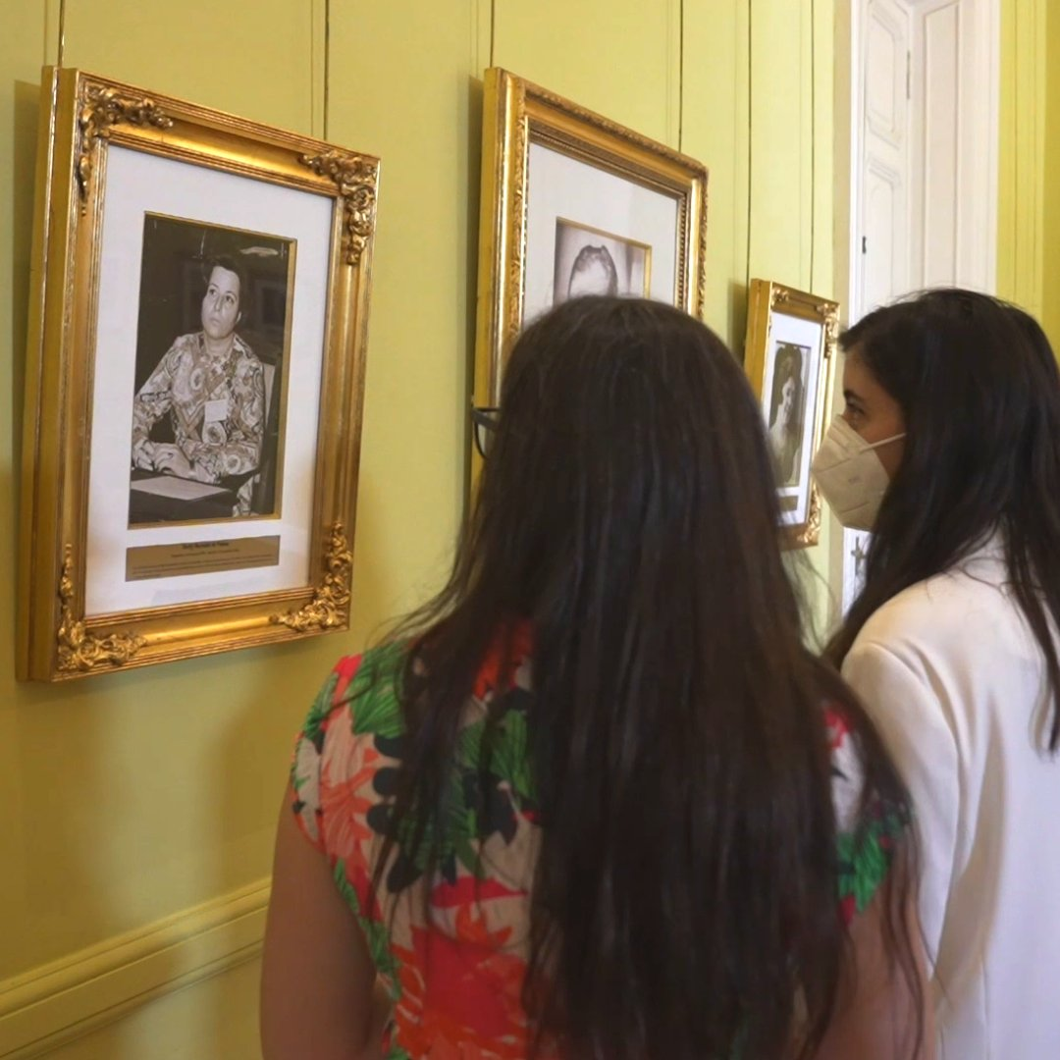
Argentine female scientists:
Eugenia Sacerdote de Lustig
(Medical Sciences)
Irene Bernasconi, María Adela Caria, Elena Martínez Fontes, Carmen Pujals (first female scientists to lead an expedition to the Antartic)
Elisa Bachofen (first female Engineer in Argentina and Latin America)
Rebeca Guber (Mathematics and Computational development)
Sara Rietti (Femal Public Servant and Director of Magister in Politics and S&T Management of UBA)
Elvira López (first graduate of Philosophy and Literature)
Telma Reca (Psychology)
Hetty Bertoldi de Pomar (Geology)
“Not only symbolically, but we are also taking key steps in the symbolic sphere.”
said the Minister of Woman, Gender and Diversity, Elizabeth Gómez Alcorta
Feb 2022
Notes:
16

Slide 17
ACTIONS
Other ongoing initiatives
All-male boards, scientific committees, organizing committees will not be funded or sponsored
Gender equity is encouraged in every board and evaluation committee
Researchers who have been denounced will not be allowed to direct fellows nor researchers
Researchers who have been denounced will not be allowed to apply for Institutes Director positions
Recognition of transgender rights: new name & authorship – updating records – gender transition processes recognized (equivalent to maternity leaves, etc.)
Gender-based violence leaves & protection (within and outside the workplace)
Kindergarten & protected spaces for breast-feeding
Notes:
17

Slide 18
FINAL CONSIDERATION
There is still a long way to go before men and women have equal opportunities in their careers, which will not be possible without changes to ensure that the voices, contributions and excellence of women scientists are placed at the top of the political, research and civil society agendas.
Notes:
18

Slide 19


Thanks for your attention
conicet.gov.ar
/CONICETDialoga
Notes:
19

